Slide 1
Sign-Language Recongnition
Project by:
Isha Anand - 181473
Vidhita Jain -181486
Supervisor
Dr. Himanshu Jindal

Slide 2


01
Table of content
02
03
04
Introduction
Objective
Library Used
Implementation
Algorithm

Slide 3
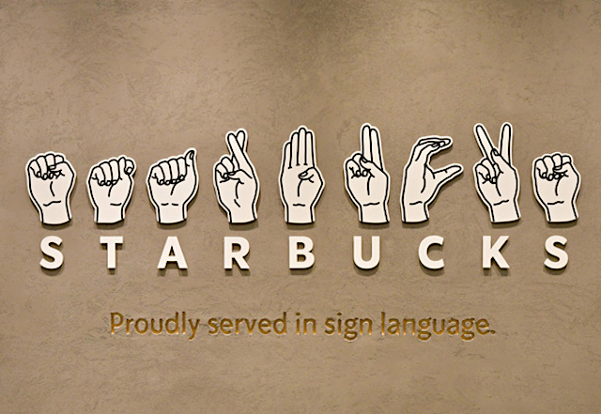
Introduction
This is a Project which detects a human hand, segments the hand using thresholding, counts the number of fingers being held up and displays the corresponding text, all from a live video input. We programmed this in Python using the open source Computer Vision library OpenCV

Slide 4
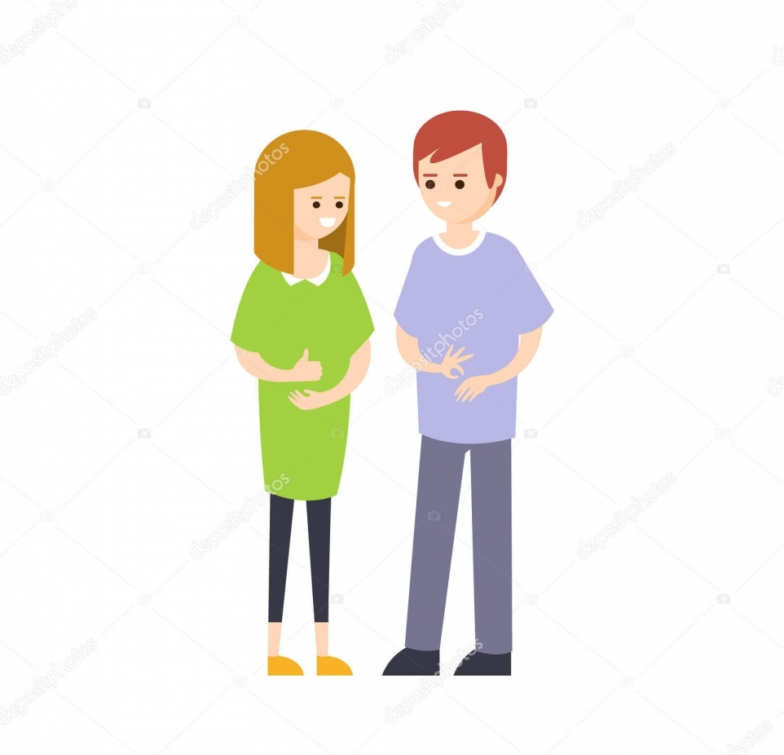
Objectives
The objective of this project is to identify the symbolic expression through images so that the communication gap between a normal and hearing impaired person can be easily bridged.
Communication is always having a great impact in every domain and how it is considered the meaning of the thoughts and expressions that attract the researchers to bridge this gap for every living being.

Slide 5
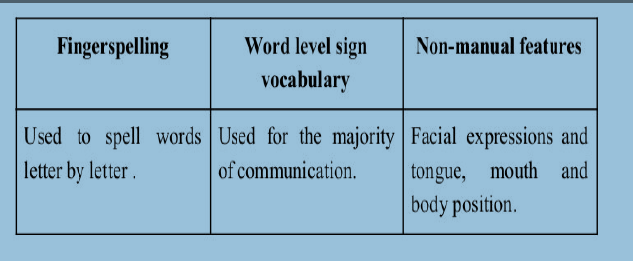
Sign language is a visual language and consisit of 3 major components:

Slide 6
Platform Used
Python as the coding language and it’s different libraries.
IDLE python as a platform for implementation
Operating system is - Windows 10

Slide 7
Python Libraries to be used:
Opencv
Numpy
Math

Slide 8
Numpy
NumPy is a library for the Python programming language, adding support for large, multi-dimensional arrays and matrices, along with a large collection of high-level mathematical functions to operate on these arrays
NumPy is the de facto standard for multidimensional arrays in Python data science, and many of the most popular libraries are built on top of it.

Slide 9
OpenCV
OpenCV (Open Source Computer Vision Library) is an open source computer vision and machine learning software library. OpenCV was built to provide a common infrastructure for computer vision applications and to accelerate the use of machine perception in the commercial products
The library has more than 2500 optimized algorithms, which includes a comprehensive set of both classic and state-of-the-art computer vision and machine learning algorithms. These algorithms can be used to detect and recognize faces, identify objects, classify human actions in videos, track camera movements, track moving objects, extract 3D models of objects, produce 3D point clouds from stereo cameras, stitch images together to produce a high resolution image of an entire scene,
.

Slide 10
Math
Python - Math Module
Some of the most popular mathematical functions are defined in the math module. These include trigonometric functions, representation functions, logarithmic functions, angle conversion functions, etc. In addition, two mathematical constants are also defined in this module are
Pi and Euler’s constant

Slide 11
How we Generate Data Set and process it?

Slide 12
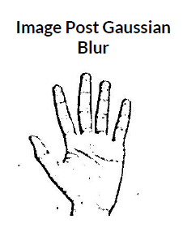
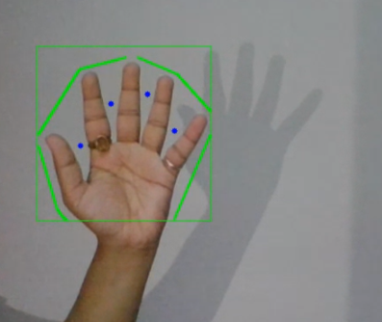
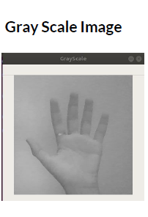
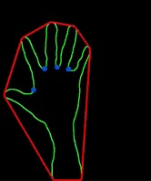
Contouring image
Capturing Raw
Image

Slide 13
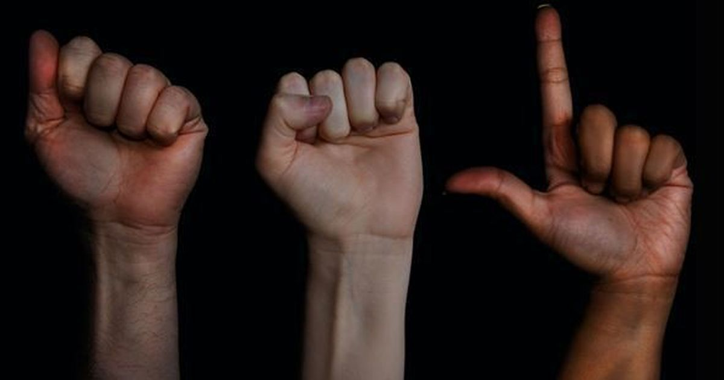
Implementation
Find the ROI(region of interest)
Hand Segmentation : Convert the video frame from BGR to HSV(or Gray)
Perform a Gaussian blur
Perform a Threshold
Find the Biggest Contour(this will be our hand)
Perform a convexHull and mark the ROI(region of interest
Count the no. of countors
Display it

Slide 14
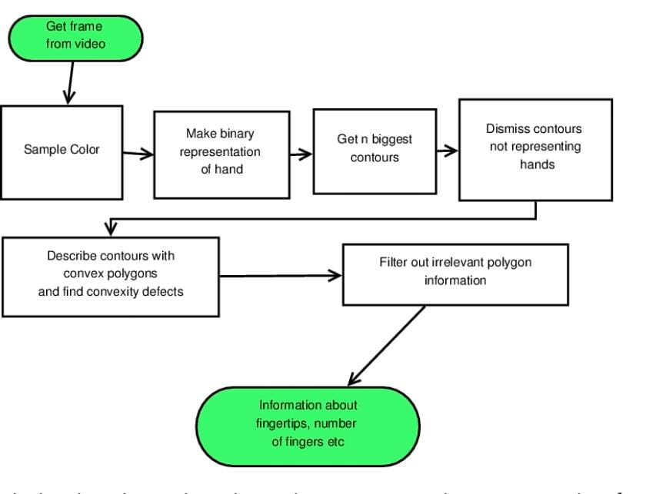
Algorithm

Slide 15
Segmentation
The most common RGB,
where any pixel is composed by the union of three colors (red, green, blue).
However, for color segmenting, the HSV
color space is much better, because in there the information of color is dissociated from the information of illumination. HSV stands for HUE (the color information), S (Saturation, e.g., the percentage of ‘color’ present) and V (Value/brightness,
e.g., the percentage of ‘white’ color present).

Slide 16
Contouring
Contours can be explained simply as a curve joining all the continuous points (along the boundary), having same color or intensity.
The contours are a useful tool for shape analysis and object detection and recognition.
For better accuracy, use binary images. So before finding contours, apply threshold or canny edge detection. To draw the contours, cv.drawContours function is used. It can also be used to draw any shape provided you have its aboundary points. Its first argument is source image, second argument is the contours which should be passed as a Python list, third argument is index of contours

Slide 17
Convex Hull
In order to detect fingertips, we are going to use the Convex Hull technique. In mathematics, Convex Hull is the smallest convex set that contains a set of points. And a convex set is a set of points such that, if we trace a straight line from any pair of points in the set, that line must be also be inside the region. The result is then a nice, smooth region, much easier to be analysed than our contour, that contains many imperfections.

Slide 18
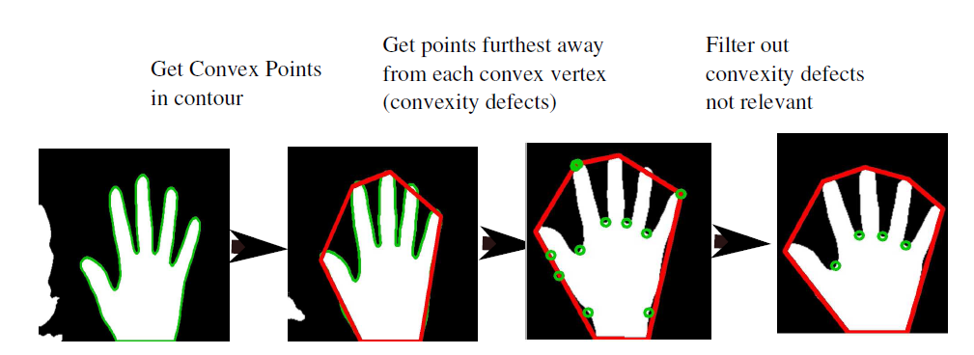
Convex hull

Slide 19
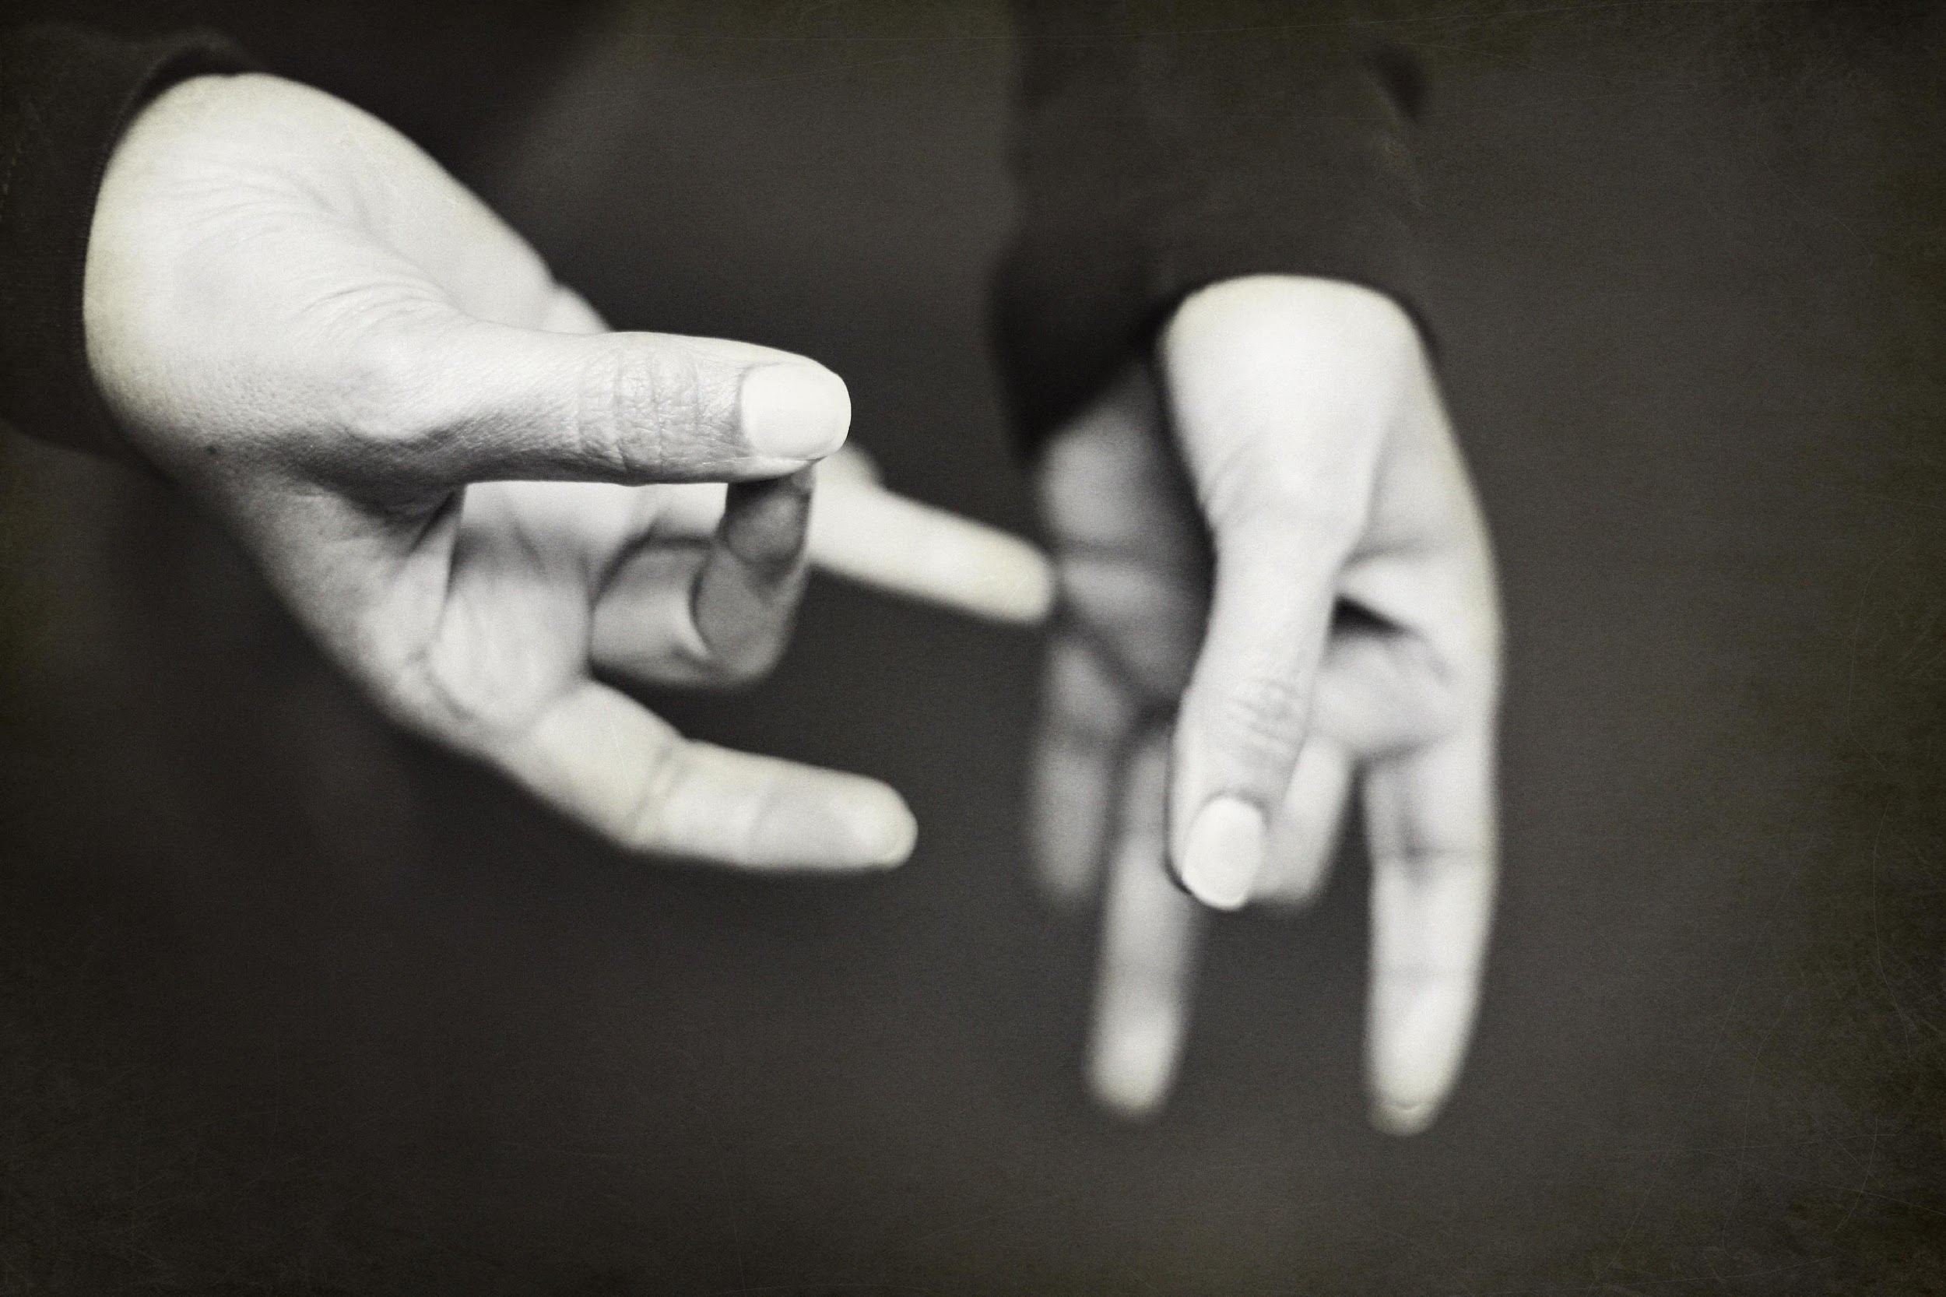
A picture always reinforces the concept
Images reveal large amounts of data, so remember: use an image instead of long texts

Slide 20
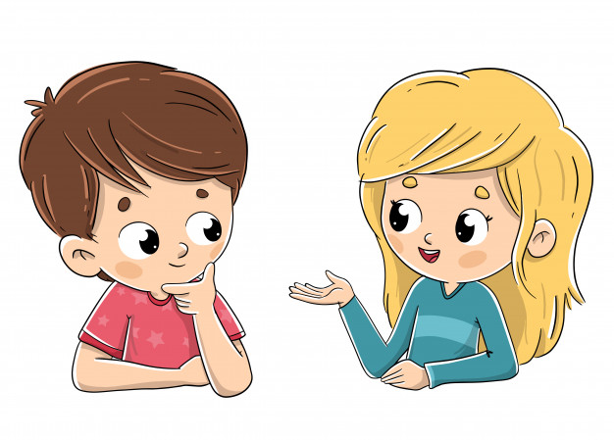
Future Work Approach
In this project we propose an idea for feasible communication between hearing impaired and normal person with the help of python
There is ever the sounding challenge to develop a sign language system in data collection remains invariant of the unconstraint environment .This project can be extended to the real-time data.

Slide 21
References
S. M. M. Roomi, R. J. Priya, and H. Jayalakshmi 2010 Hand Gesture Recognition for Human- Computer Interaction (J. Comput. Science vol. 6) no. 9 pp. 1002–1007.
Naresh Kumar(2017). Sign Language Recognition for Hearing Impaired People based on Hands Symbols Classification. International Conference on Computing, Communication and Automation (ICCCA2017)
P. B. Nayana and S. Kubakaddi 2014 Implentation of Hand Gesture Recognition Technique for HCI Using Open CV (International Journal of Recent Dev) vol. 2 no. 5 pp 17–21

Slide 22


Thank You
PROJECT BY:
Isha Anand - 181473
Vidhita Jain - 181486

